Slide 1
CS 531 - E-Commerce Interface
Group Lambda - Λ
Name | From | Year
Sai Ramya Kadali | India | Spring 2022
Ramaswamy Iyappan | India | Spring 2022
Lakshmi Chetana Gomaram Bikshapathireddy | India | Spring 2022
Sai Sucharitha Ginjupalli | India | Spring 2022
Course Instructor: Shambhu Sainju

Slide 2
Contribution of the Team Members
Sai Ramya Kadali :
Worked on implementation of admin module for insertion and deletion of the data. Have worked on the presentation slides.
Ramaswamy Iyappan:
Worked on implementation of admin module for displaying the data and shopping cart, bill generation module.
Lakshmi Chetana Gomaram Bikshapathireddy:
Collected data and created tables in MySQL. Performed testing and also added required code documentation. Worked on presentation slides.
Sai Sucharitha Ginjupalli:
Collected data and created tables in MySQL. Worked on searching for products module.

Slide 3

Pros and Cons of working in a group
Pros | Cons
We can get different inputs and think from others perspective | Conflicts arise, when everyone in group don’t agree to the same point
Discussions result in gaining more knowledge and effective problem solving. | Decision making takes time
Sharing the work and responsibility | Various opinions might sometimes result in various outcomes of the task.
Building communication skills and professional relationships | Working in teams sometimes requires more number of meetings.
Team work and quality in leadership | There can be challenges in planning.
Working in a group is better because of the efficient way of working but it is a time taking process.

Slide 4
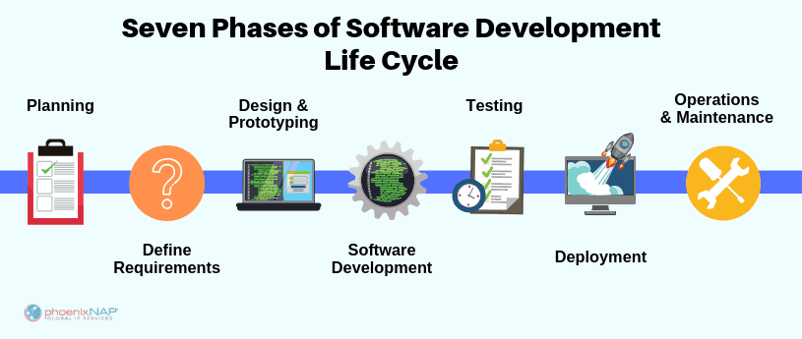
Preliminary Analysis:
Objectives:
Show the replica of an e-commerce application.
Implement using C and MySQL technologies.
Nature and Scope of the problem under study:
Develop an application where users can buy and sell online.
The future scope of the project can be to implement using front-end technologies and give users a better view and easy access.
System Analysis:
Collection of facts:
Observed the working of amazon (e-commerce application).
Collected the data and created database required for project.
Algorithm is designed to meet the requirement.

Slide 5
System Design:
Flow Chart

Slide 6
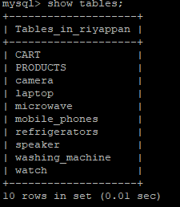
Development:
Each functionality is developed in separate modules
Data Base is created and maintained
Modules:
DataBase:
admin.c | shows the working of admin tasks
cart.c | shows the working of cart tasks
display.c | displaying the tables in order
insert.c | insertion of data
main.c | implementation of main functionalities
search.c | shows the working of search module
Write_To_File.c | prints the generated bill

Slide 7

Integration and Testing:
We have initially performed the unit testing where we tested the modules separately.
Later we performed the integration testing to check the working of modules when combined.
The data base connection and modules which are working on data manipulation are tested.

Slide 8
Acceptance, Installation and Deployment:
Software Requirements:
Programming Language | C
Database | MySQL
Editor | VI Editor
Connector to server | Cisco AnyConnect, Putty
Code Execution
Steps:
Connect to Cisco AnyConnect
Connect to Zues server through putty
Compile the program

Slide 9
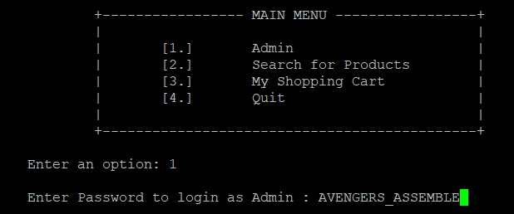
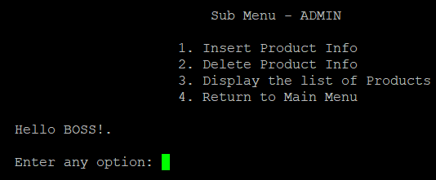
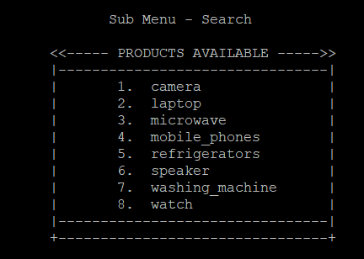
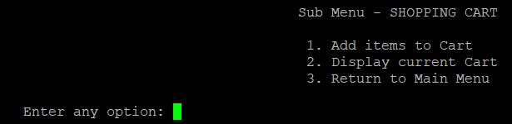
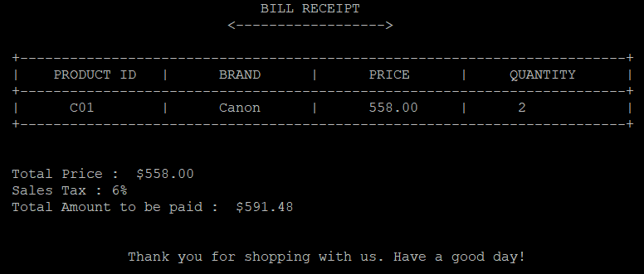
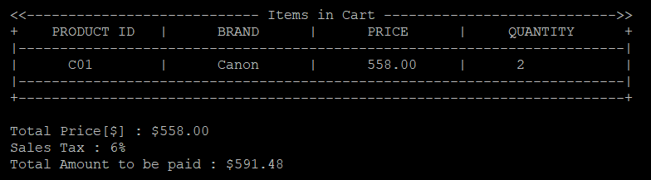
Output:

Slide 10
Conclusion:
It is one of the best way to improve the shopping experience hassle free
E-Commerce can be used by small business people to promote and sell their goods
Future Enhancements:
The User Interface can be improved more efficiently
Automation of the entire system improves the efficiency
The interface can be made dynamic
Images of the products can be added
Thank You

